Slide 1
Java Basics

Slide 2
Contents
Class & Object
Object Life Cycle
Method in Java
Constructors
Main program in Java
Packages
Heap Memory
Varargs
AutoBoxing

Slide 3
Class & Object
Class is nothing but a blueprint or a structure that is used to create an object
A class should always start with an uppercase first letter, and that the name of the java file should match the class name.
Object has some behaviour and does something
Objects have states and behaviors.
An object is an instance of a class

Slide 4
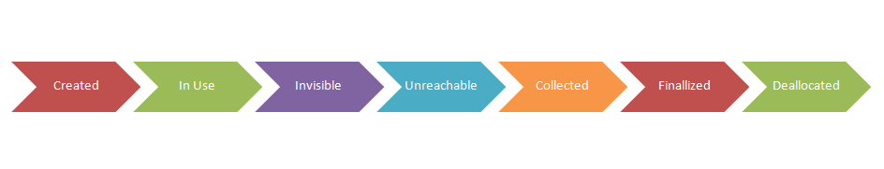
Object Life Cycle

Slide 5
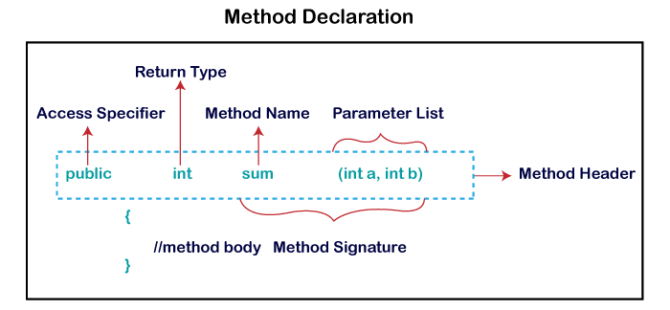
Method in Java
A method is a block of code or collection of statements or a set of code grouped together to perform a certain task or operation

Slide 6
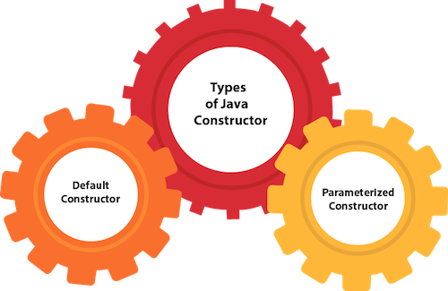
Constructors
A constructor is a block of codes similar to the method. It is called when an instance of the class is created.

Slide 7
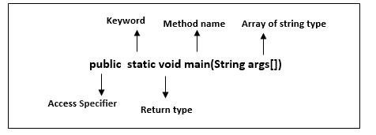
Main program in Java

Slide 8
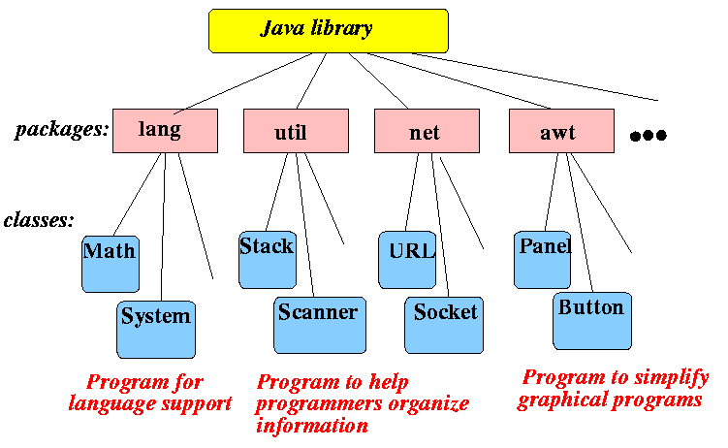
Packages
A java package is a group of similar types of classes, interfaces and sub-packages.

Slide 9
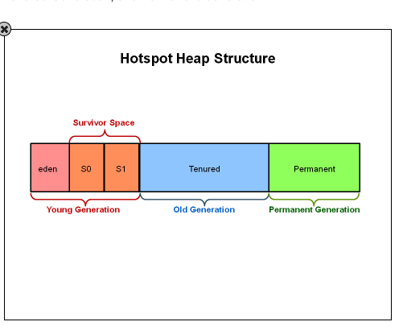
Heap Memory

Slide 10
Varargs
Varargs is a short name for variable arguments. In Java, an argument of a method can accept arbitrary number of values. This argument that can accept variable number of values is called varargs.
SYNTAX:
return_type method_name(data_type... variableName){}

Slide 11
AutoBoxing
Autoboxing is the process by which a primitive type is automatically encapsulated (boxed) into its equivalent type wrappers whenever an object of the type is needed.

Slide 12
THANK YOU

